Slide 1
Presentation on Excel worksheet
Presenting by,
1.Md.Al-Amin Golder
Department of Botany.
University of Barishal.
Presenting to,
Md.Mahbub-E-Noor
Assistant Professor
Department of CSE

Slide 2
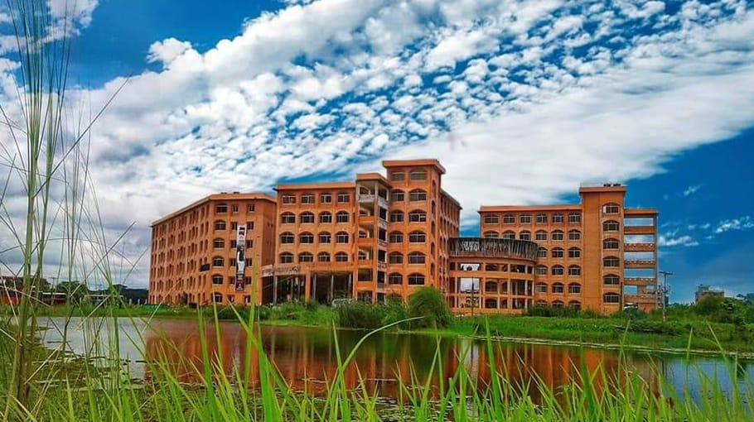
Welcome
to
Our Presentation

Slide 3
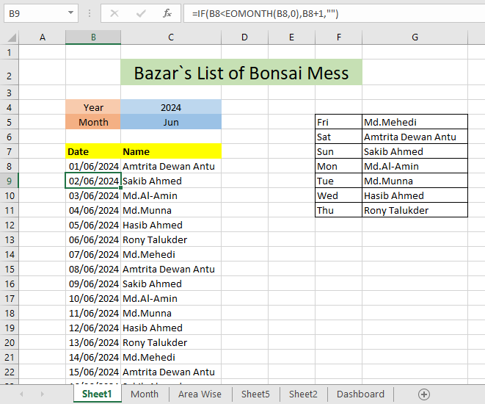
Bazar list of Bonsai Mess
Link

Slide 4
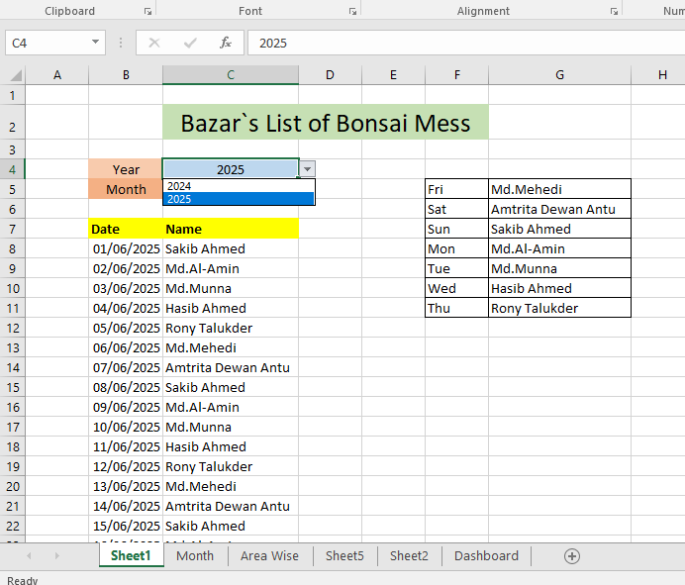
Yearwise Changes
Yearwise changes

Slide 5
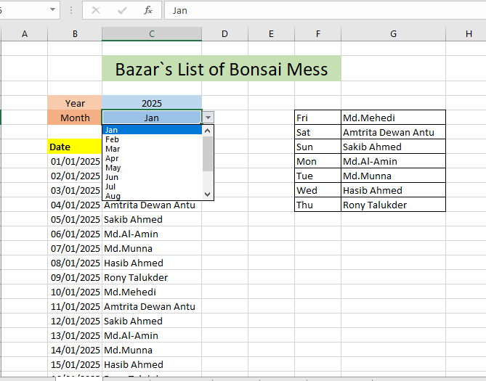
Monthwise Changes
Monthwise Changes

Slide 6
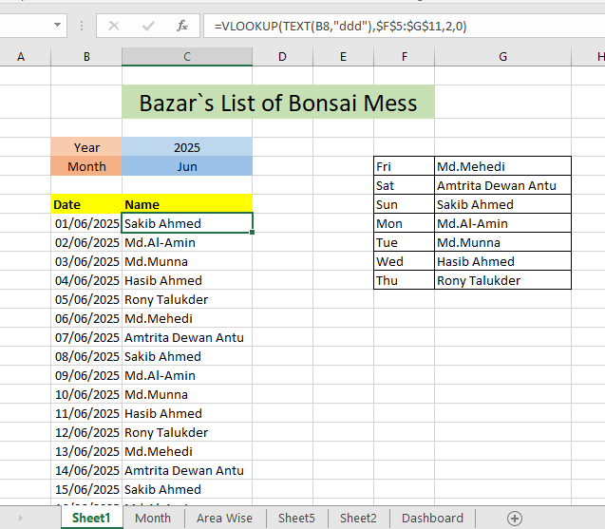
Function
Changes name according to month & Year
Link

Slide 7
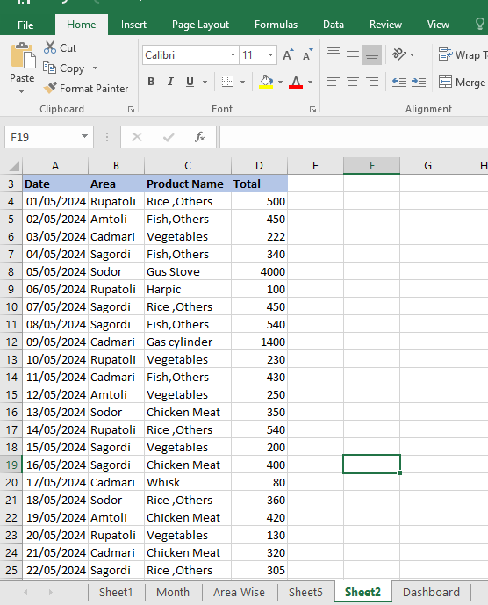
Pivot Table

Slide 8
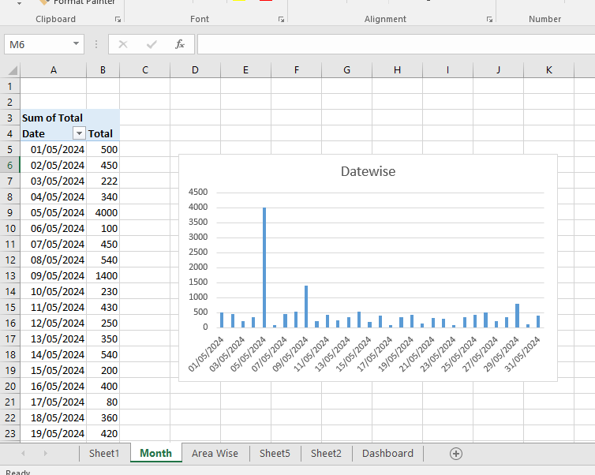
Column Chart According to Date

Slide 9
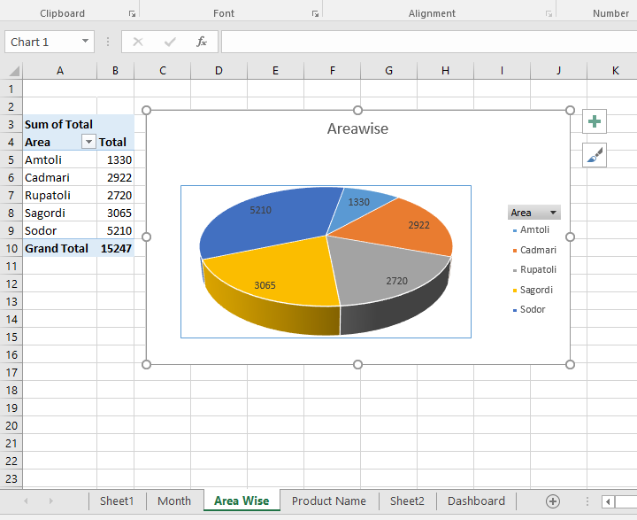
Pie Chart According to Area

Slide 10
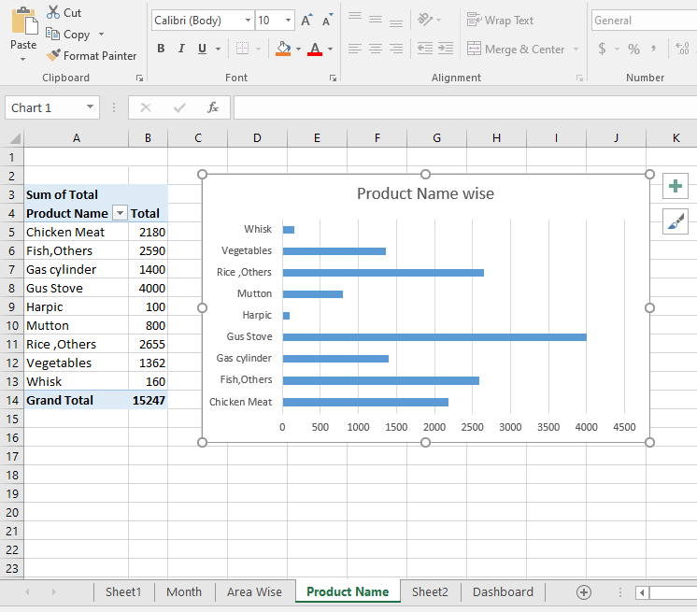
Bar Chart According to Product Name
Link

Slide 11
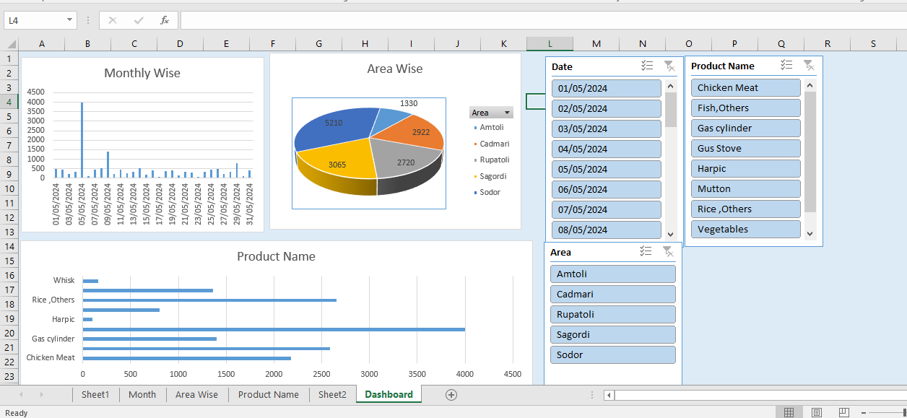
Dashboard

Slide 12
Formulas that use in this Project
DATAVALUE
IF
TEXT
AND
VLOOKUP
PIVOT TABLE

Slide 13
Thank You

